Slide 1

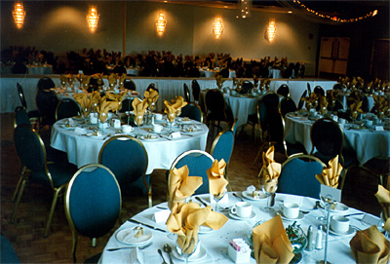

Comp 2615
Lab2
Hosting a Formal Dinner
Group 5:
Jen Crothers
Winter Liu
Chet Woodside

Slide 2

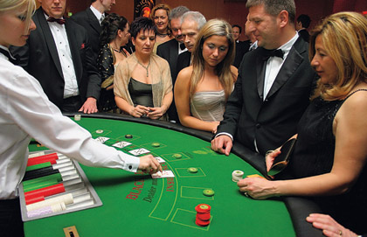

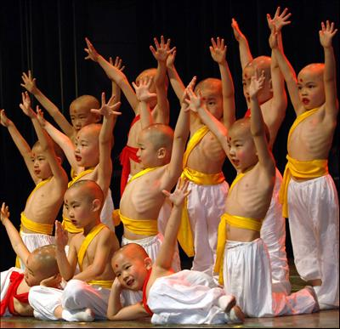


Scope Definition
What:
Formal Charity Dinner
When:
International Children’s Day (June 1st)
Who:
Local Video Game Executives
Why:
BC Children’s Hospital Fundraiser
Overview and Vision

Slide 3

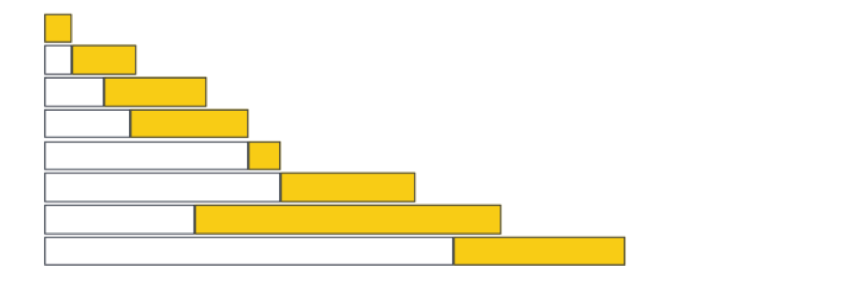
Schedule
Jan 6 - Jan 19
Scope Definition
Jan 19 - Feb 7
Problem Analysis
Jan 29 - Feb 14
Requirements Analysis
Feb 4 - Feb 20
Logical Design
Feb 20 - Feb 28
Decision Analysis
Mar 1 - Mar 22
Physical Design
Feb 14 - May 1
Construction & Testing
April 18 - June 1
Installation/Delivery
Budget
Project Participants
- Budget is limited by ticket price.
- Chief party organizer.
- Projected costs is $10,000.
- Assistant party organizers (2).
- Tickets will cost $200.00.
- Chef, Marketing/Sales, Staffing
- Require at least 50 attendees to
company.
break even.
Scope Definition (continued)

Slide 4

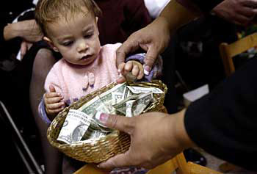
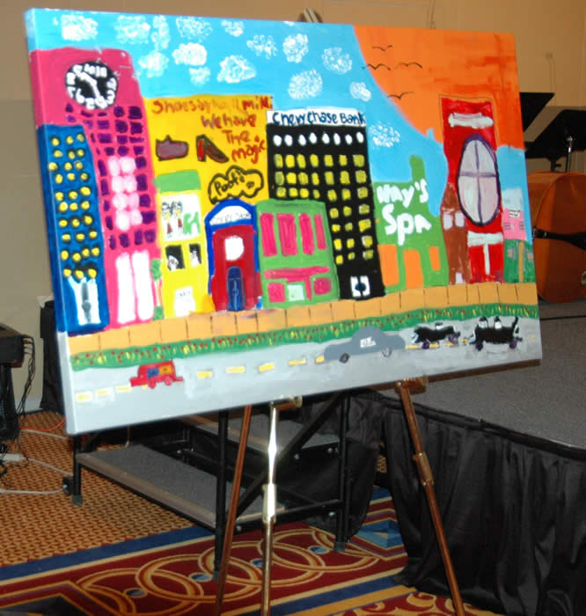

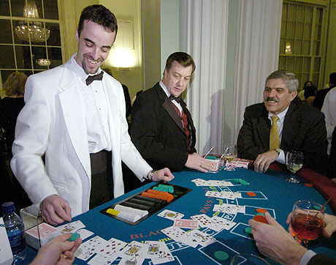
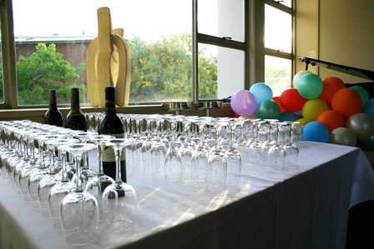
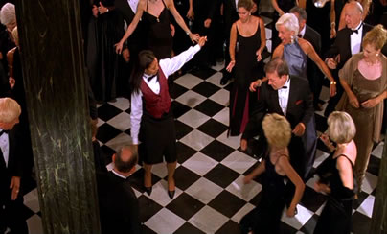
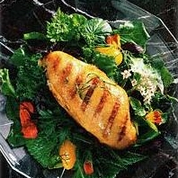
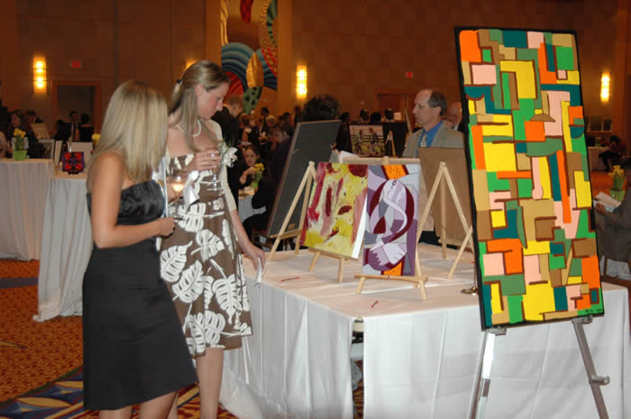
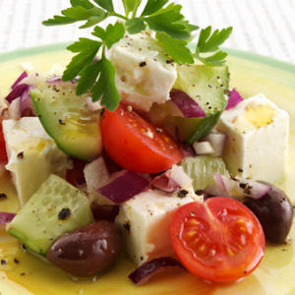
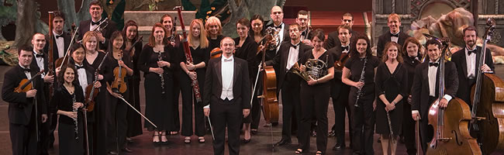
Problem Analysis
How to create a lively, entertaining and charitable event.

Slide 5
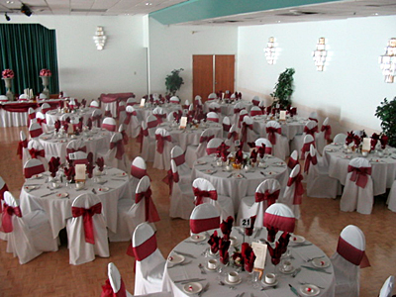
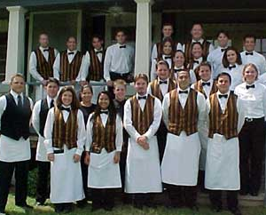
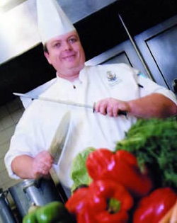
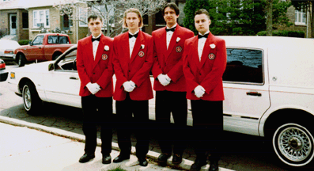
Requirements Analysis
Notes:
Seating for 100
Sufficient space for guests to mingle
Sufficient washrooms
Delicious gourmet food using BC ingredients
Sufficient parking for guests
Valet parking service

Slide 6
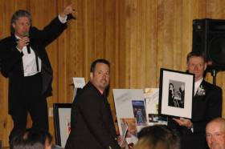
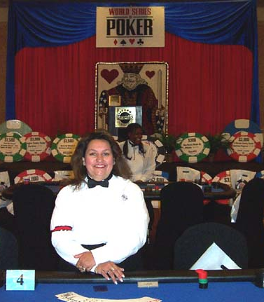
Requirements Analysis
(continued)
Notes:
- children's paintings.
- a means to display the items for auction.
- auctioneer and podium/gavel.

Slide 7
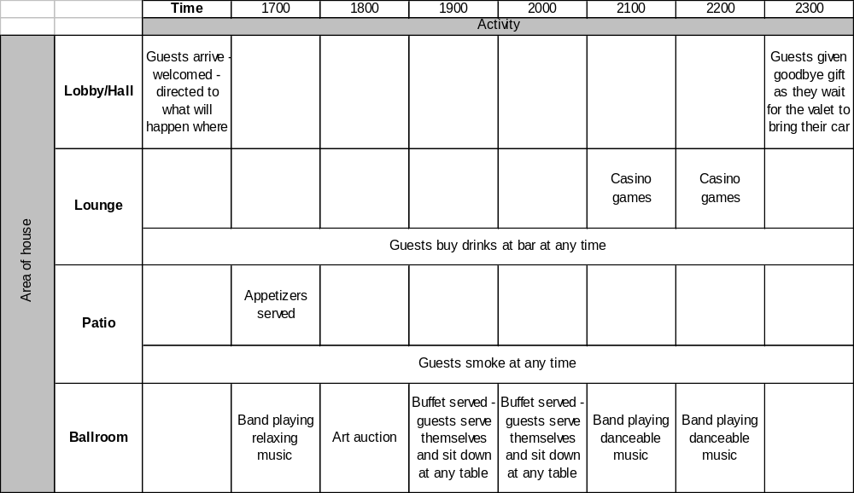
Logical Design

Slide 8
Options
Hold art auction first and casino games second 2. Hold casino games first and art auction second
Analysis
The art auction is a more serious entertainment event and would have broader appeal.
The casino games will appeal to a smaller subsection of the guests.
Recommendation
It would be better to go for Option 1 for the following reasons:
▪ As the night progresses more people will go home;
▪ As the night progresses more people will get more intoxicated;
▪ If people are not interested in casino games they can dance or talk.
Decision Analysis
Notes:
(1) identify candidate technical solutions
Option 1
Hold art auction first and casino games second
Option 2
Hold casino games first and art auction second
(2) analyze those candidate solutions for feasibility, and
The art auction is a more serious entertainment event and would have broader appeal. The casino games will appeal to a smaller subsection of the guests. The games are based on luck, not skill, and the house has a solid advantage.
(3) recommend a candidate system as the target solution to be designed.
It would be better to go for Option 1 for the following reasons:
▪ As the night progresses more people will go home;
▪ As the night progresses more people will get more intoxicated;
▪ If people are not interested in casino games they can dance or talk.

Slide 9
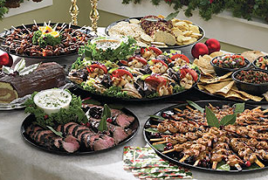

Menu
Using local, organic, seasonal produce where possible
Crab, prawns, oysters, scallops
Roast lamb, beef, pork
Lots of different salads
Fresh stir fried vegetables
Fruit and cheese platters
Dips and crackers
Cakes and pastries
Physical Design
Notes:
The deal
For a $200 ticket a guest gets:
Appetizers
Sumptuous gourmet buffet – with a focus on BC produce
Two bottles of champagne per table of 10
Unlimited red or white wine and soft drinks at dinner
Entertainment
Music – something quirky to appeal to youthful audience
Auction - an auction of paintings done by kids currently in long term care in the hospital
Casino games – blackjack and roulette

Slide 10
Ensure that chef’s recipes will actually work and that ingredients are available
Set up tables and see if everything fits
Walk through venue with an eye to where each activity will be taking place
Construction & Testing

Slide 11
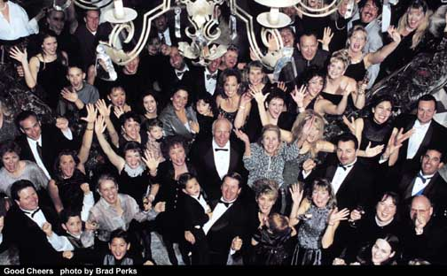
Installation & Delivery
Notes:
A huge success, raising $50,000 for the Children’s Hospital and getting lots of positive media for the game company executives.

